Slide 1
Enterprise Application Development Using Spring Boot
Unit 1: Introduction to Enterprise Applications & Spring Boot
By: Akshay Shinde

Slide 2
What are Enterprise Applications?
Large-scale software used in business environments
Designed to support operations like HR, Billing, Inventory
Must be scalable, secure, maintainable
Examples:
ERP Systems
E-Commerce Platforms
Banking Applications

Slide 3
Fundamentals of Enterprise Application Development
Multi-tier architecture: UI, Business Logic, Data Layer
Persistence Layer (JPA, Hibernate)
Security: Authentication & Authorization
Emphasis on code modularity & design patterns

Slide 4
Modern Software Architecture
Monolithic vs Microservices
Feature | Monolithic | Microservices
Deploy | Single Unit | Independent Services
Tech Stack | Single | Polyglot Possible
Scaling | Entire App | Per Microservice
Maintenance | Complex | Easier

Slide 5
Maintainable Enterprise Solutions
Layered Architecture (Controller, Service, Repository)
Loose Coupling with Interfaces
Proper Logging & Exception Handling
Use of Version Control (Git), CI/CD Pipelines

Slide 6
Overview of Spring Ecosystem
Popular Spring Modules:
Spring Core (DI)
Spring MVC (Web)
Spring Data JPA (Database)
Spring Security (Auth)
Spring Boot (Rapid Dev)

Slide 7
Introduction to Spring Boot
Simplifies Spring app development
Embedded Tomcat/Jetty
Auto-configuration
Spring Initializr
No XML Configuration
Minimal App Code:
@SpringBootApplication
public class MyApp {
public static void main(String[] args) {
SpringApplication.run(MyApp.class, args);
}
}

Slide 8
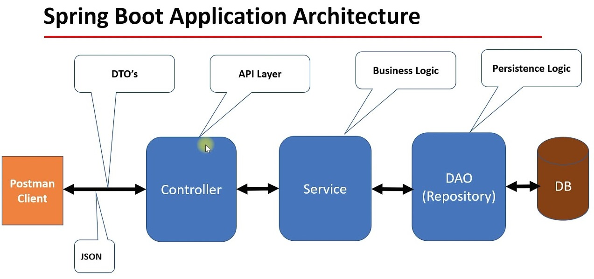

Slide 9
Java-Based Enterprise Application Structure
com.example.demo
|-- controller
|-- service
|-- repository
|-- model
|-- DemoApplication.java
Follows standard layered approach

Slide 10
Build Tools - Maven vs Gradle
Feature | Maven | Gradle
Language | XML | Groovy/Kotlin DSL
Speed | Slower | Incremental Builds
Adoption | Wide Use | Gaining Popularity
Maven Dependency:
<dependency>
<groupId>org.springframework.boot</groupId>
<artifactId>spring-boot-starter-web</artifactId>
</dependency>

Slide 11
Spring Boot Application Structure
DemoApplication.java - Main Class
application.properties - Config
pom.xml / build.gradle - Dependencies
src/main/java - Logic
src/main/resources - Configs
Example Config:
server.port=8081
spring.datasource.url=jdbc:mysql://localhost:3306/demo

Slide 12
Summary
Enterprise apps need scalability & modularity
Monolithic vs Microservices: Choose based on use-case
Spring Boot simplifies enterprise Java dev
Tools: Maven/Gradle, Git, JPA, REST

Slide 13
Exercises - Unit 1
Lab 1: Set Up Spring Boot Project
- Use Spring Initializr (https://start.spring.io)
- Select dependencies: Spring Web, Spring Boot DevTools
- Create and run a Hello World REST API
Lab 2: Explore Project Structure
- Understand folders: controller, service, repository
- Add your own REST endpoint
Lab 3: Maven Hands-on
- Modify pom.xml to add a new dependency
- Run mvn clean install and observe the result
Lab 4: Properties Configuration
- Change server port in application.properties
- Add custom properties and print them in controller using @Value

Slide 14
Q&A
Any Questions? Let's Discuss!

Slide 15
Spring Vs Spring Boot

Slide 16
Thank You
Akshay Shinde
Founder: Tech Amplifiers, CognaTech Solutions
Committed to Amplify Your Skills

